Slide 1
WORK-LIFE
&
PRIVATE-LIFE
BALANCE

Slide 2
PRANAMS
AT
THE LOTUS FEET
OF
BHAGAVAN SRI SATHYA SAI BABA

Slide 3


Slide 4
FAQs
What is work?
What is entertainment?
Why people work?
What is life?
What is the meaning of WLB?
Why there should be balance between work life and private life?
What will happen if we focus either on work-life or private life?
How can one balance it?

Slide 5
QUOTES ON WORK
“The only place where success comes before work is in the dictionary.”
Pleasure in the job puts perfection in the work. Aristotle (384 BC - 322 BC)
A human being must have occupation if he or she is not to become a nuisance to the world.
Dorothy L. Sayers (1893 - 1957)
Plans are only good intentions unless they immediately degenerate into hard work.
Peter Drucker (1909 - 2005)

Slide 6
FUNNY QUOTES ON WORK
BUSINESS CONVENTIONS ARE IMPORTANT BECAUSE THEY DEMONSTRATE HOW MANY PEOPLE A COMPANY CAN OPERATE WITHOUT.
WHENEVER YOU ARE ASKED IF YOU CAN DO A JOB, TELL 'EM, "CERTAINLY, I CAN!" THEN GET BUSY AND FIND OUT HOW TO DO IT.
CONWAY'S LAW: IN ANY ORGANIZATION THERE WILL ALWAYS BE ONE PERSON WHO KNOWS WHAT IS GOING ON - THIS PERSON MUST BE FIRED.
AN ANT ON THE MOVE DOES MORE THAN A DOZING OX.
MY GRANDFATHER ONCE TOLD ME THAT THERE WERE TWO KINDS OF PEOPLE: THOSE WHO DO THE WORK AND THOSE WHO TAKE THE CREDIT. HE TOLD ME TO TRY TO BE IN THE FIRST GROUP; THERE WAS MUCH LESS COMPETITION.
IN THE WORLD THERE ARE TWO TYPES OF PEOPLE: HARD WORKING PEOPLE AND HARDLY WORKING PEOPLE.
IF A EQUALS SUCCESS, THEN THE FORMULA IS: A = X + Y + Z, X IS WORK. Y IS PLAY. Z IS KEEP YOUR MOUTH SHUT.
--ALBERT EINSTEIN

Slide 7
WORK: MEANING
VARIOUS TASKS AND RESPONSIBILITIES THAT ONE UNDERTAKES IN HIS/HER WORK PLACE, WHICH FORM PART OF HIS/HER JOB.
WORK IS INTENDED TO BE ONE OF THE MOST PROFOUND WAYS OF EXPERIENCING THE DIVINE PRESENCE IN THE WORLD, THAT IS, OF EXPERIENCING SPIRITUALITY

Slide 8


DIFFERENCE BETWEEN
WORK
ENTERTAINMENT
STORY OF A FARMER AND AN ARTIST

Slide 9
OBJECTIVES OF WORK
TO ENGAGE ONE’S OWN SELF AND ESCHEW IDLENESS
TO EARN LIVELIHOOD
TO EARN IDENTITY
TO PUT TO USE ONE’S OWN KNOWLEDGE, SKILLS, AND ABILITIES
TO SHARPEN ONE’S OWN KNOWLEDGE, SKILLS, AND ABILITIES AND GAIN EXCELLENCE IN A CHOSEN FIELD
TO SERVE SOCIETY THROUGH WORK
TO GAIN MEANING IN LIFE
TO WEAR OUT ONE’S OWN “KARMIC BALANCE”

Slide 10
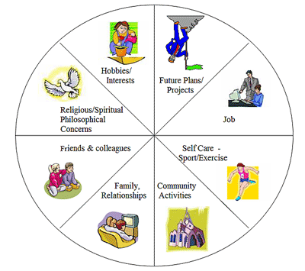
FACETS OF LIFE

Slide 11
TIME AVAILABLE FOR WORK AND LIFE
S.NO. | ITEM | HOURS | % | %
1 | TOTAL NUMBER OF HOURS AVAILABLE IN LIFE (ASSUMING THAT A PERSON LIVES FOR 70 YRS) [1 = 2+4+5+6+7] OR [4 + 8] | 6,13,200 | 100.00
2 | TIME SPENT ON SLEEPING (ASSUMING THAT ONE ON AN AVERAGE HAS ABOUT 8 HOURS OF SLEEP) | 2,04,400 | 33.33
3 | TIME SPENT WHILE AWAKE (16 HOURS PER DAY FOR 70 YEARS) [3 = 4+5+6+7] | 4,08,800 | 66.67 | 100.00
4 | TIME SPENT AT/FOR WORK OR WORK LIFE [10 HOURS PER DAY] | 2,55,500 | 41.67 | 62.50
5 | TIME SPENT ON PERSONAL ABLUTIONS AND HYGIENE [1 HOUR PER DAY] | 25,550 | 4.17 | 6.25
6 | TIME SPENT ON EATING AND DRINKING [2 HOURS PER DAY] | 51,100 | 8.33 | 12.50
7 | TIME SPENT ON ENTERTAINMENT, RECREATION, UNWINDING, SOCIALIZING, ETC. [3 HOURS PER DAY] | 76,650 | 12.50 | 18.75
8 | PRIVATE LIFE = [2+5+6+7] [14 HRS PER DAY] | 3,57,700 | 58.33

Slide 12
CONSEQUENCES OF IMBALANCE
WORK-LIFE
PRIVATE LIFE
WORKAHOLIC
LEISUREAHOLIC

Slide 13
MEANING
WORK-LIFE BALANCE IS A BROAD CONCEPT INCLUDING PROPER PRIORITIZING BETWEEN "WORK" (CAREER AND AMBITION) ON ONE HAND AND "LIFE" (PLEASURE, LEISURE, FAMILY AND SPIRITUAL DEVELOPMENT) ON THE OTHER.
RELATED, THOUGH BROADER, TERMS INCLUDE "LIFESTYLE BALANCE" AND "LIFE BALANCE".

Slide 14
CLARIFICATIONS ABOUT WLB!
WORK-LIFE BALANCE DOES NOT MEAN AN EQUAL BALANCE.
YOUR BEST INDIVIDUAL WORK-LIFE BALANCE WILL VARY OVER TIME, OFTEN ON A DAILY BASIS.
THERE IS NO PERFECT, ONE-SIZE FITS ALL, BALANCE YOU SHOULD BE STRIVING FOR. THE BEST WORK-LIFE BALANCE IS DIFFERENT FOR EACH OF US BECAUSE WE ALL HAVE DIFFERENT PRIORITIES AND DIFFERENT LIVES.

Slide 15
2 IMPORTANT CONCEPTS OF WLB
        ACHIEVEMENT
        ENJOYMENT

Slide 16
WHO IS RESPONSIBLE FOR WLB?
        INDIVIDUAL [75%]
        ORGANISATION [20%]
        SOCIETY [10%]
  INTERNAL vs EXTERNAL LOC

Slide 17
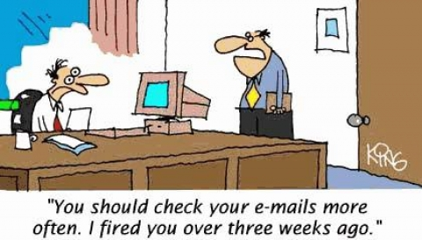

Slide 18
A STORY ABOUT EVERYBODY
THIS IS A STORY ABOUT FOUR PEOPLE NAMED EVERYBODY, SOMEBODY, ANYBODY, AND NOBODY.
THERE WAS AN IMPORTANT JOB TO BE DONE AND EVERYBODY WAS ASKED TO DO IT. EVERYBODY WAS SURE SOMEBODY WOULD DO IT. ANYBODY COULD HAVE DONE IT, BUT NOBODY DID IT.
SOMEBODY GOT ANGRY ABOUT THAT, BECAUSE IT WAS EVERYBODY'S JOB. EVERYBODY THOUGHT ANYBODY COULD DO IT BUT NOBODY REALIZED THAT EVERYBODY WOULDN'T DO IT.
IT ENDED UP THAT EVERYBODY BLAMED SOMEBODY WHEN NOBODY DID WHAT ANYBODY COULD HAVE DONE.

Slide 19
THE END
SAI RAM

